Slide 1
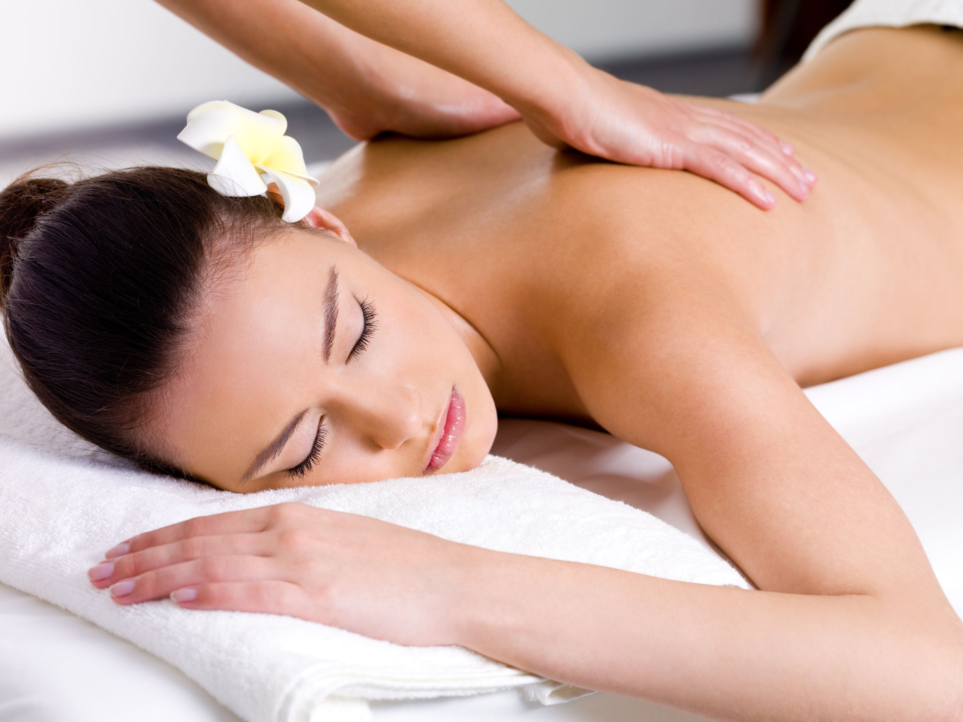
REPLENISH YOUR WELL-BEING
Total Skin Rejuvenation Package
5x Microderm Radiance facials
Includes
- Customised mask
- Hand Treatment
- Take home product
$499
(Valued at $759)
Conditions Apply

